Slide 1

Data Science

Slide 2


Hello! Instructor Introduction
Instructor: Anshu Pandey
Microsoft Certified Trainer
Data Scientist
Microsoft Certified Azure AI Associate
TechTrunk Venutres
A Data Scientist and AI Architect having 8+ years of experience of working with organizations to develop Data Science and AI Applications and helping them with AI Transformation.

Slide 3
Data Science

Slide 4

Artificial Intelligence

Slide 5
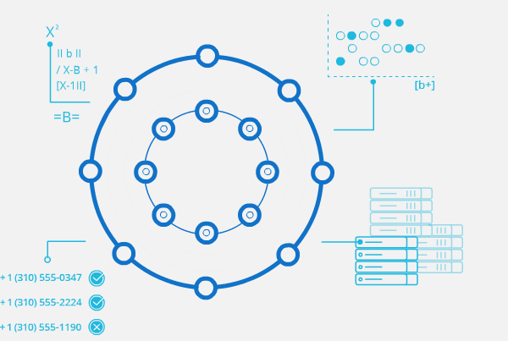
What is Artificial Intelligence?
“The capability of a machine to imitate intelligent human behavior“
Notes:
the theory and development of computer systems able to perform tasks normally requiring human intelligence, such as visual perception, speech recognition, decision-making, and translation between languages

Slide 6
What is Artificial Intelligence?
Machine
or Computers
Artificial Intelligence
+
Intelligence
=

Slide 7
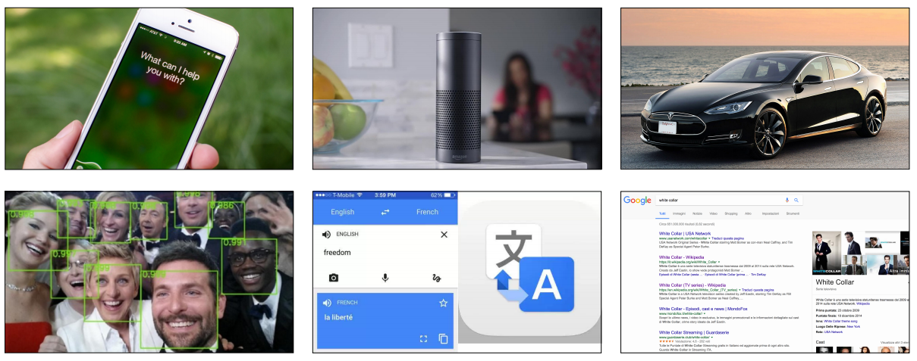
Artificial Intelligence in everyday products

Slide 8
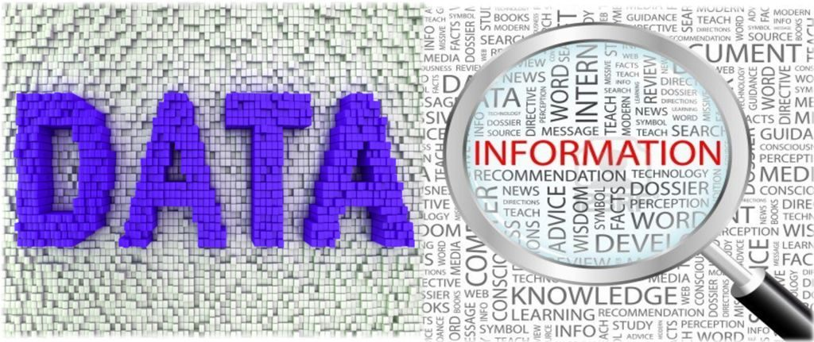
What is Data?
Structured
Business Data, Excel, CSV
Unstructured
Text, Images and Speech

Slide 9
Early 1950 Optimism began
Artificial Intelligence
1980’s Machine Learning begins to flourish
Machine Learning
2010 Deep Learning breakthroughs
Deep Learning

Slide 10
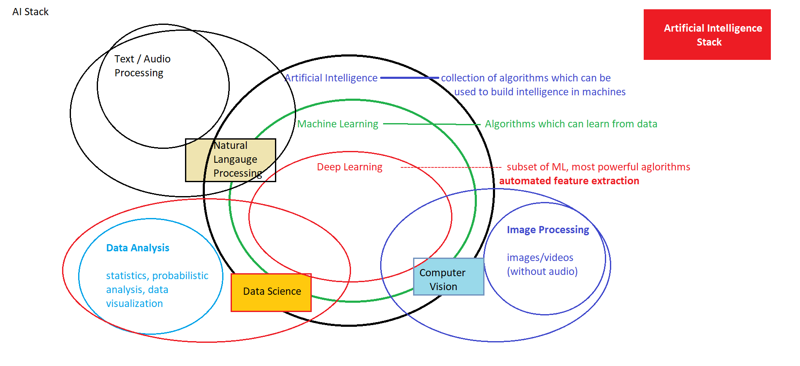

Slide 11
Artificial Intelligence
Data Science
Computer Vision
Natural Language Processing

Slide 12
Artificial Intelligence
Data Science
Predicting Stock prices, housing prices or any other item prices based on historical data
Predicting whether customer will buy a product or not, customer will churn or not
Classifying the customers in different known groups
Risk predictions for financial transactions.
Fraud Detection from transactional data
Segmentation of customers, stocks and server logs
Predicting patient readmission into hospital
Detecting anomalies in access management, data control
Building product recommendation systems
Computer Vision
Natural Language Processing

Slide 13
Artificial Intelligence
Data Science
Face Recognition, Emotion Recognition
Optical Character Recognition
Document verification, authentication
Object Detection and Classification from images
Identifying forgery in the images
Vehicle number plate, type recognition
Self Driving Cars – lane detection, traffic sign classification, Behavioural Cloning
Motion Detection from videos
Image restoration, colouring and pattern transfer
Action Prediction
Computer Vision
Natural Language Processing

Slide 14
Artificial Intelligence
Data Science
Text/document classification
Social Media Text mining and Analysis
Speech to Text and Text to Speech conversion
Caption generation
Machine Translation
Sentiment analysis from text
Chatbots
Speaker recognition
Personal Assistant, Sentence Correction
Text Generation, Similarity Matching, Topic Modelling
Computer Vision
Natural Language Processing

Slide 15
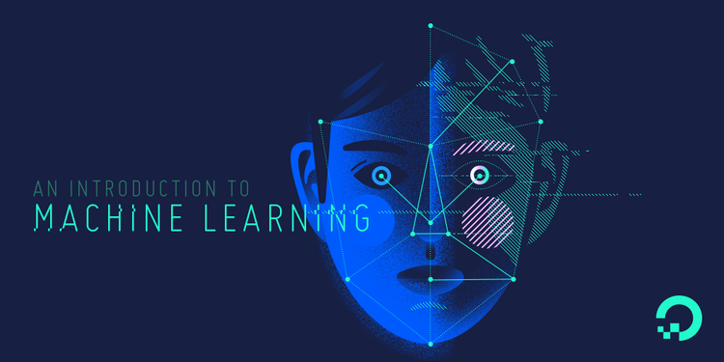

Slide 16

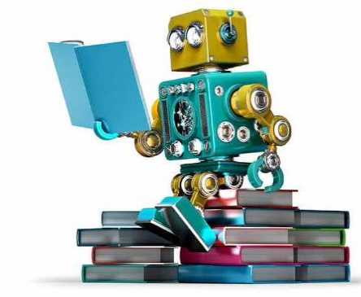
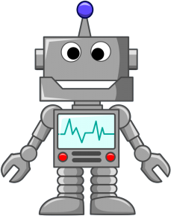

Slide 17
Machine learning is a field of computer science that gives computers the ability to learn without being explicitly programmed.
—Arthur Samuel, 1959

Slide 18
“Classical” decision making
(explicit instructions)
Requires ‘a priori’ knowledge
Feature | Input | Procedure | Output
F0 | [0.8] | if F1 > 0.5 and F2 * F3 < 0.3: if (F4 – F5) / F6 < 1: do A else: if F7 * F0 < 0.3: do B else: do C else: do D | “A”
F1 | [0.2]
F2 | [0.9] |  | “B”
F3 | [0.2]
F4 | [0.0] |  | “C”
F5 | [0.4]
F6 | [0.3] |  | “D”
F7 | [0.1]

Slide 19
ML decision making
Requires no (or very little) ‘a priori’ knowledge
Feature | Input | Procedure | Output
F0 | [0.8] | Output = MATRIX * Input (Linear Regression) Output = g( M2 * f( M1 * Input) ) (Neural Network with one hidden layer) | “A”
F1 | [0.2]
F2 | [0.9] |  | “B”
F3 | [0.2]
F4 | [0.0] |  | “C”
F5 | [0.4]
F6 | [0.3] |  | “D”
F7 | [0.1]

Slide 20
Applications of Machine Learning
Financial Predictions, Fraud Detections
Loan Approval
Data Mining – Web Click Data, Medical Records, Diagnosis
Predictive Maintenance
Ad plus user information
Computer Vision – Face Recognition, Self Driving Cars, OCR
Churn Prediction, Customer Segmentation, Sales Forecasting
Voice recognition, Chatbots, Sentiment Analysis, Machine Translation

Slide 21
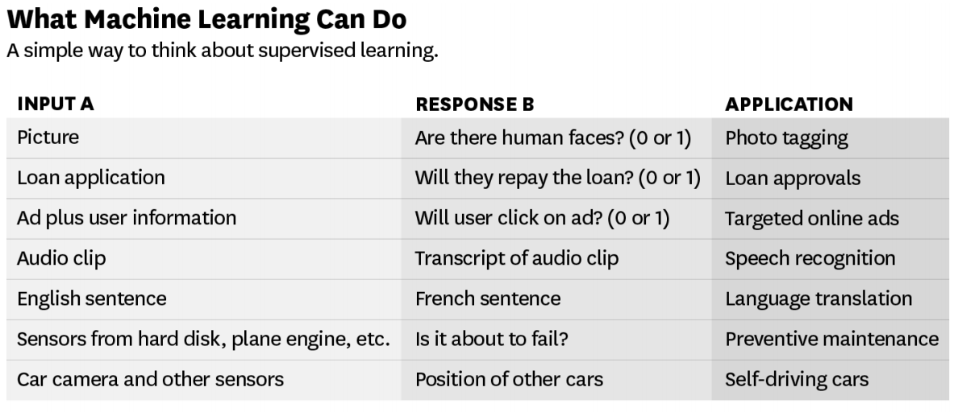
Source – ANDREW NG

Slide 22
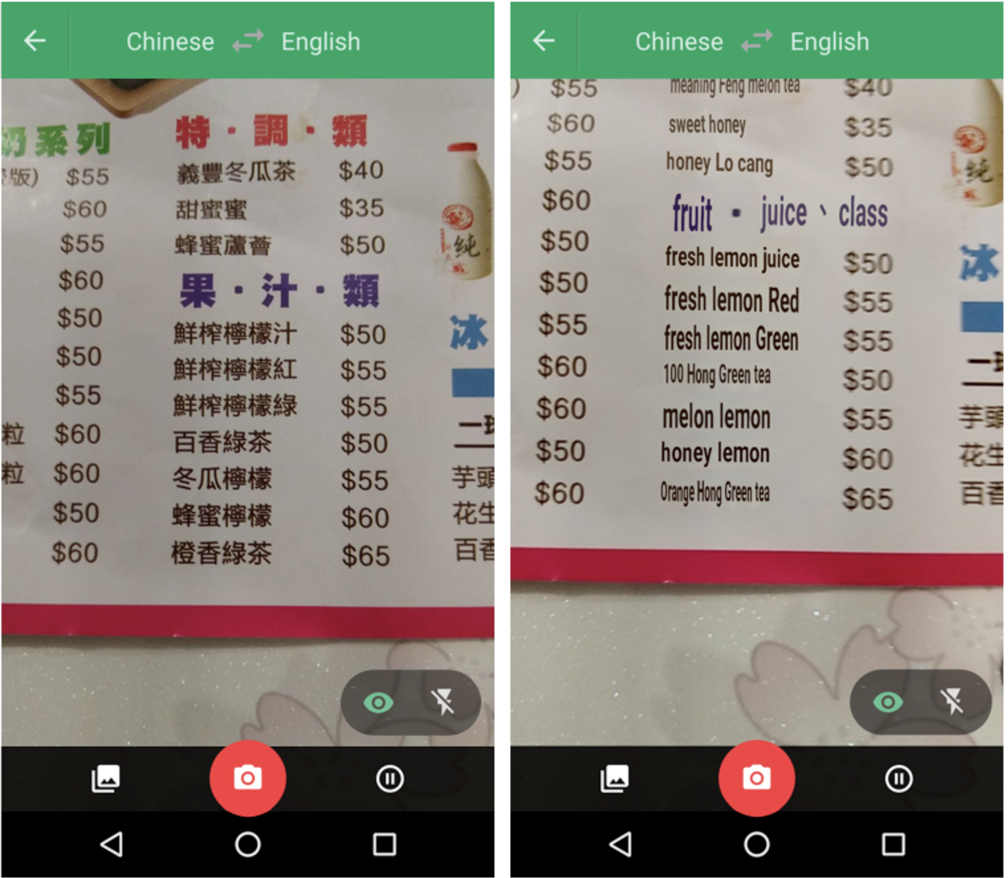
!!
Point your camera at the menu during your next trip to Taiwan and the restaurant’s selections will magically appear in English via the Google Translate app.
Google Translate overlaying English translations on a drink menu in real time using convolutional neural networks.

Slide 23
Manufacturing | Retail | Financial Services
Predictive maintenance or condition monitoring Warranty reserve estimation Propensity to buy Demand forecasting Process optimization Telematics | Predictive inventory planning Recommendation engines Upsell and cross-channel marketing Market segmentation and targeting Customer ROI and lifetime value | Risk Analytics and Regulations Customer Segmentation Cross-selling and up-selling Sales and marketing campaign management Credit worthiness evaluation
Travel and Hospitability | Health Care and Life Sciences | Energy, Feedstock and Utility
Aircraft scheduling Dynamic pricing Social media — consumer feedback and interaction analysis Customer complaint resolution Traffic patterns and congestion management | Alerts and diagnostics from real-time patient data Disease identification and risk stratification Patient triage optimization Proactive health management Healthcare provider sentiment analysis | Power usage analytics Seismic data processing Carbon emissions and trading Customer-specific pricing Smart grid management Energy demand and supply optimization

Slide 24

Netradyne
Netradyne’s Driveri, a powerful camera that analyses driving patterns and can help determine the cause of an accident. The soap-bar-sized device is attached to a vehicle’s rear-view mirror and rests on the inside of the windscreen, pointing towards the road.

Slide 25
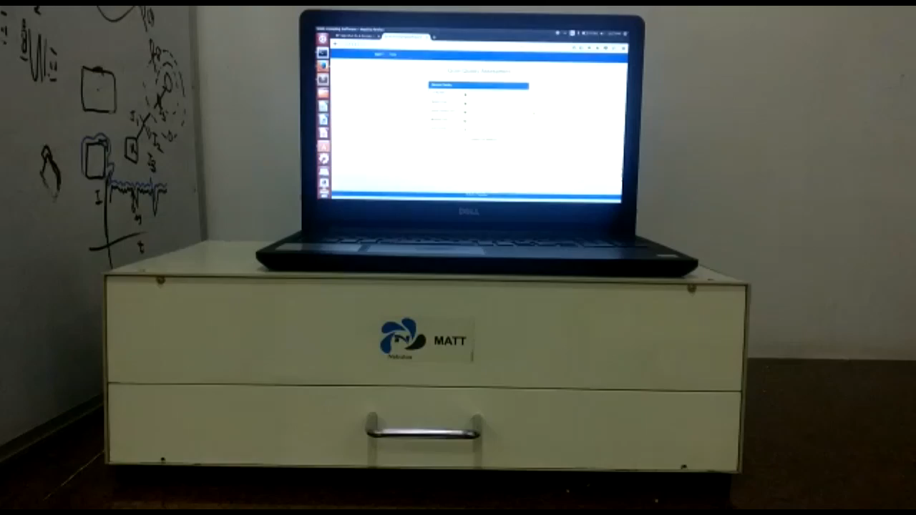
Nebulaa
http://www.nebulaa.in/
Powering Agriculture with Machine Learning

Slide 26


Deep-Domain Conversational AI to Power the Next Generation of Voice and Chat Assistants

Slide 27
Programming Languages -
Python | R

Slide 28
Machine Learning Cloud Platforms -
Microsoft Azure ML Studio
https://azure.microsoft.com/en-us/services/machine-learning-studio/
Amazon Machine Learning
https://aws.amazon.com/aml/
SAP Leonardo Machine Learning
https://www.sap.com/india/products/leonardo/machine-learning.html
Google ML Platform
https://cloud.google.com/products/machine-learning/
IBM Machine Learning
https://www.ibm.com/analytics/data-science/machine-learning

Slide 29
What to learn in machine Learning?
Programming and
Tools
30%
Python/R, spark etc.
The Math behind
Machine Learning
70%
Probabilistic Theory, Statistics and Linear Algebra

Slide 30
What to learn in Machine Learning?
Python for Machine Learning
Packages for Machine Learning – Tensorflow, keras etc.
Handling Big Data
Practice, practice & practice
Optimization, boosting Techniques
Statistics for Data Science
Math behind Machine Learning Algorithms

Slide 31
Machine Learning Techniques

Slide 32
Discovering patterns in unlabeled data.
Cluster similar documents based on the text content.
Learning based on feedback or reward.
Learn to play chess by winning or losing.
Learning with a labeled training set.
Email spam detector with training set of already labeled emails.
Supervised Learning
Unsupervised Learning
Reinforcement Learning

Slide 33




Supervised Learning
We know what we are trying to predict. We use some examples that we (and the model) know the answer to, to “train” our model. It can then generate predictions to examples we don’t know the answer to.
Examples: Predict the price a house will sell at. Identify the gender of someone based on a photograph.

Slide 34


Unsupervised Learning
We don’t know what we are trying to predict. We are trying to identify some naturally occurring patterns in the data which may be informative.
Examples: Try to identify “clusters” of customers based on data we have on them

Slide 35
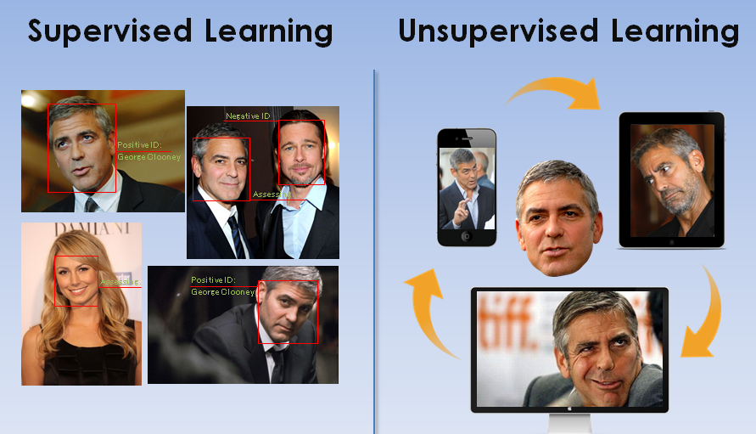

Slide 36
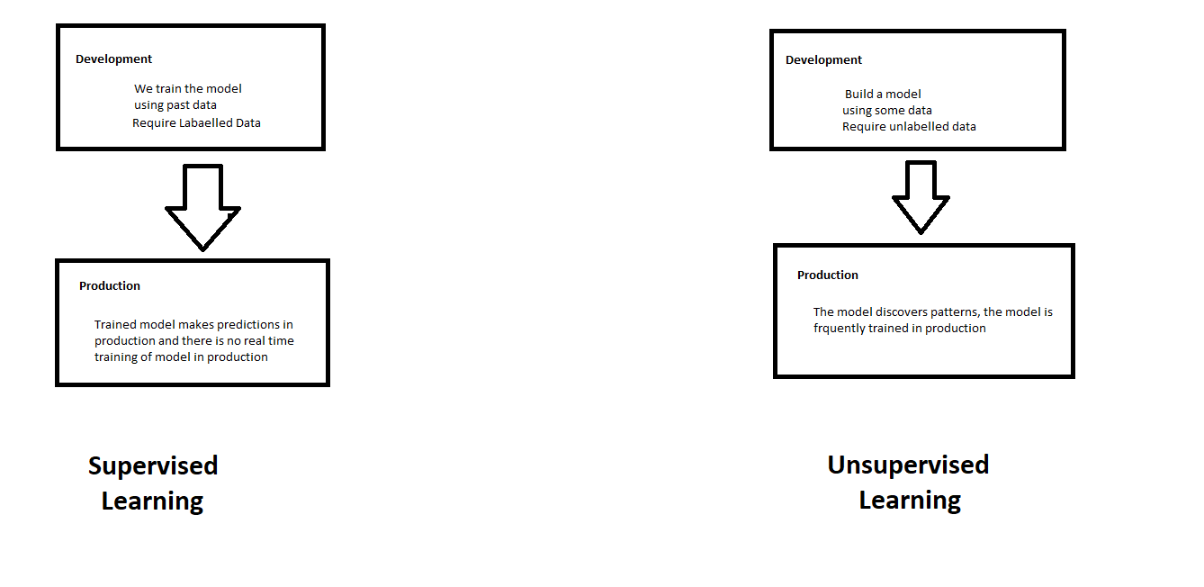
Supervised and Unsupervised Learning

Slide 37
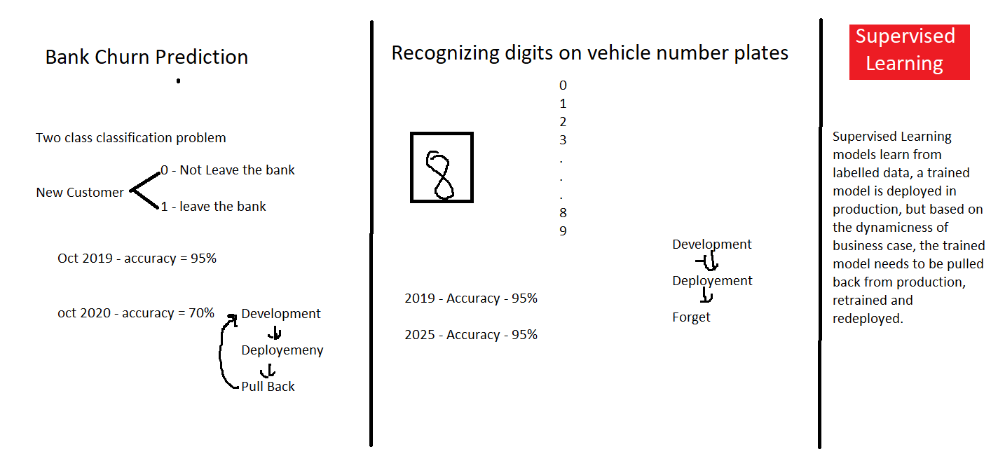

Slide 38
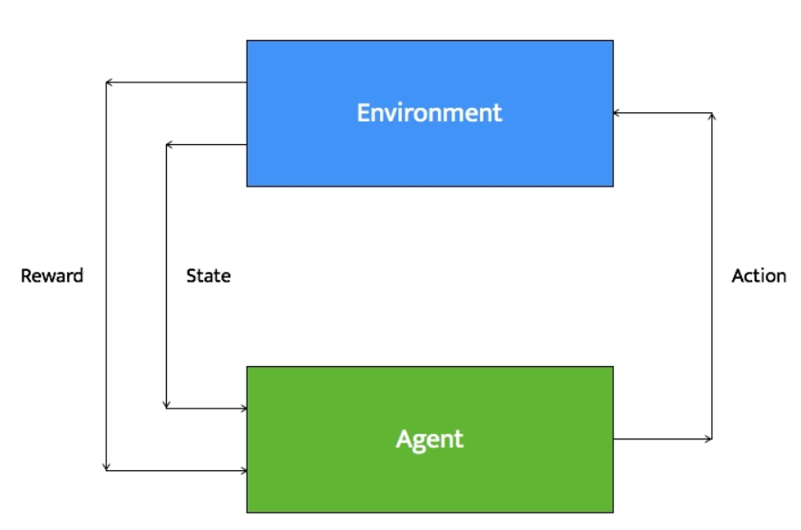
Reinforcement Learning
Reinforcement learning systems can do multiple things simultaneously -- learn by performing a trial and error search, learn the model of the environment it is in, and then use that model to plan the next steps.
Example: Let's consider a robot whose job is to explore a new building. It has to make sure it has enough power left to come back to the base station. This robot has to decide if it should make decisions by considering the trade off between the amount of information collected and the ability to reach back to base station safely.

Slide 39
Types of Problems in Machine Learning

Slide 40
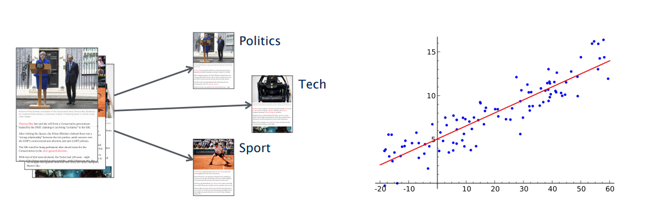
Types of Problems in Supervised Machine Learning -
Classification
(discrete set of possible outcomes)
Regression
(possible outcome can by any numerical value with in a particular continuous range)

Slide 41
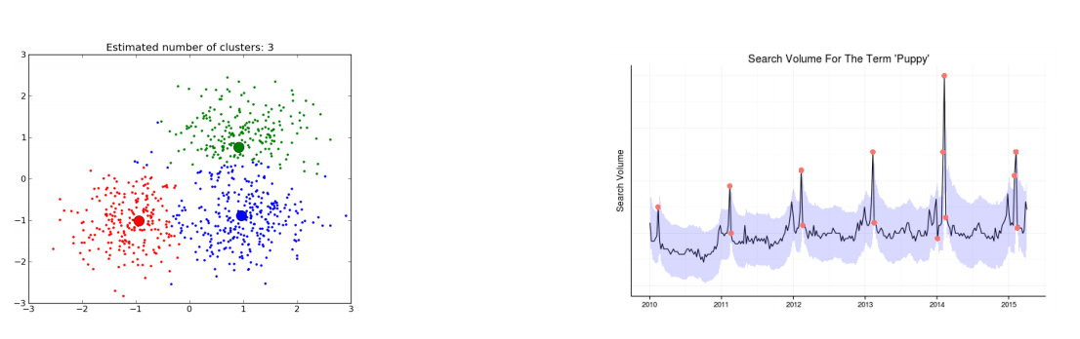
Types of Problems in Unsupervised Machine Learning -
Clustering
(categorization of samples based on similarity in features)
Anomaly Detection
(detecting an anomaly in a general pattern)

Slide 42

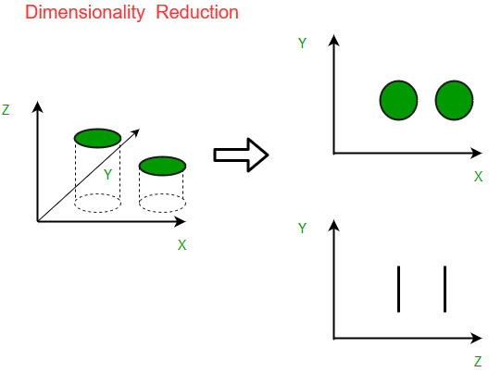
Types of Problems in Unsupervised Machine Learning -
Recommendation Systems
(profiling of users and items and recommending relevant items to user)
Dimensionality Reduction
(Reducing dimensionality/size of data)

Slide 43
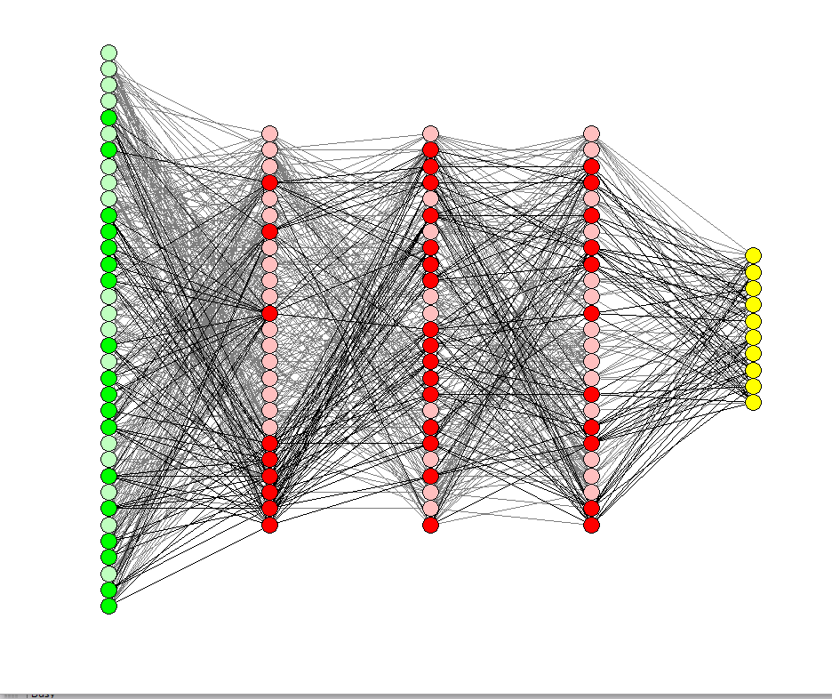
Deep Learning

Slide 44
Deep Learning
Deep Learning is part of the machine learning field of learning representations of data. Exceptional effective at learning patterns.

Slide 45
Deep Learning in one slide
What is it:
Extract useful patterns from data.
How:
Neural network + optimization
How (Practical):
Python + TensorFlow & friends
Hard Part:
Good Questions + Good Data
Why now:
Data, hardware, community, tools, investment
Where do we stand?
Most big questions of intelligence have not been answered nor properly formulated
Exciting progress:
Face recognition
Image classification
Speech recognition
Text to speech generation
Handwriting transcription
Machine translation
Medical diagnosis
Cars: drivable area, lane keeping
Digital assistants
Ads, search, social recommendations
Game playing with deep RL

Slide 46
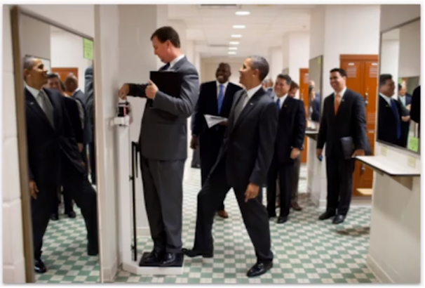
What we can’t do with Deep Learning?
Mirrors
Sparse information
3D Structure
Physics
What’s on peoples’ minds?
What happens next?
Humor

Slide 47
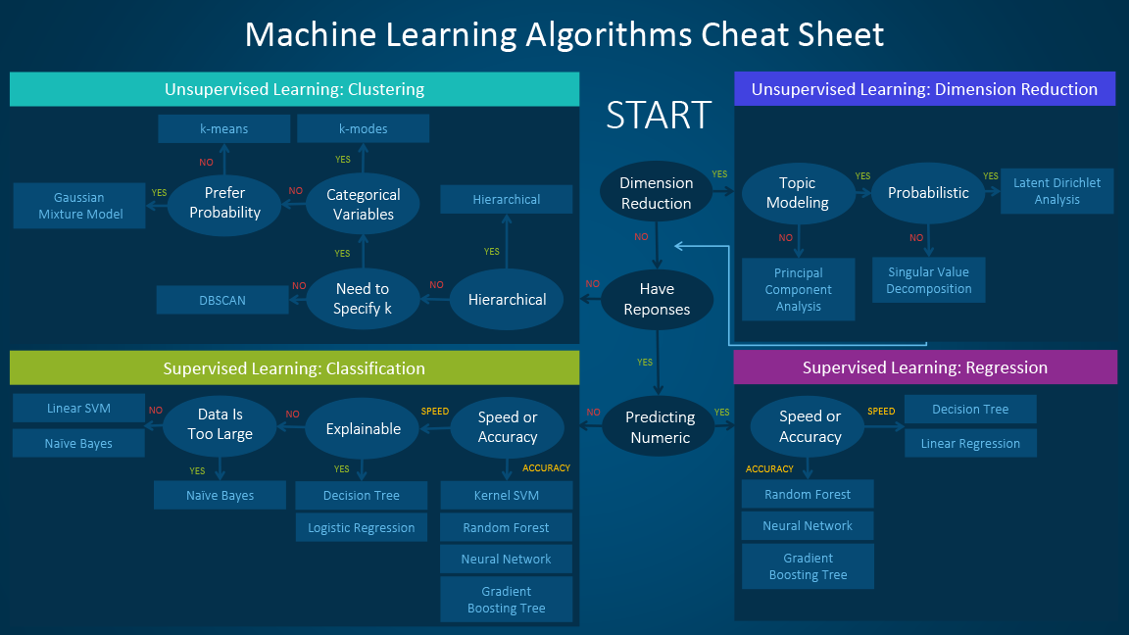

Slide 48
Happy Learning!
Stay Tuned for next exciting sessions on diving deeper into Supervised Learning

